Slide 1
Pathogenic bacteria.
Dr.Munira Ch. Ismail Lec.6

Slide 2
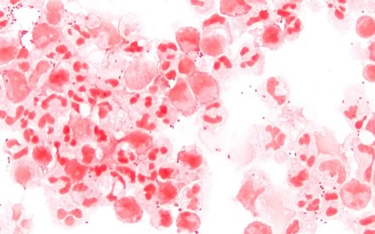
. GRAM NEGATIVE DIPLOCOCCI.
1. GENUS: NEISSERIA.
Characteristics:
. They are nopn-motile, gram-negative intacellular diplococcic.
. Rapidly killed by drying, sunlight, heat, and disinfectants.
. Ferment carbohydrate produucing acid but not gas.
. Each cocci is kidney-shaped with adjacent concave sides.
. Grow best on complex media under aerobic conditions containing 5% Co2.
. Oxidase positive.

Slide 3
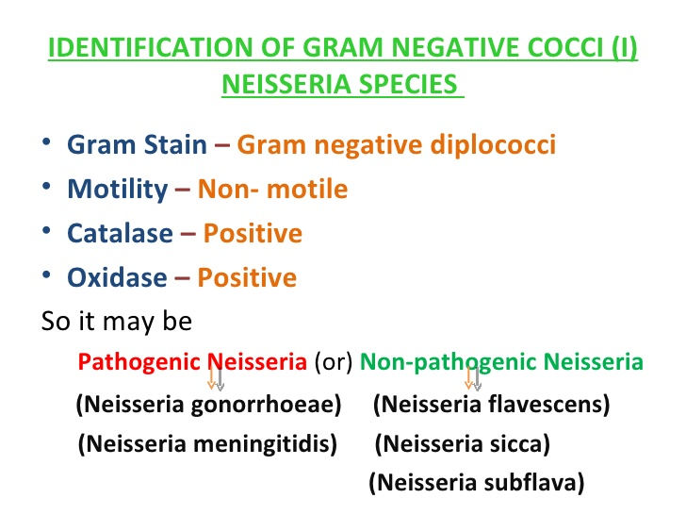

Slide 4
. The main species of medical importance are:
N. meningitides.
N.gonorrhoea.
N. gonorrhoea.
Characteristics: An obligate parasite of the human urogenital tract.
Route of infection: Sexual contact.
Male:
. Gonococcal urethritis
If complicated: Urethral stricture
Gonococcal epididymitis
Gonococcal epididymo-orchitis
Infertility
. Gonococcal suppurative arthritis

Slide 5
Female:
. Gonococcal cervicitis
. Gonococcal salpingitis
If compicated: Gonococcal tubo-ovarian abscess
Pelvic peritonitis
Infertility
Infant (When delivered through the infected birth canal).
. Gonococcal ophthalmia neonatorum ,If untreated and complicated leads to blindness.
Gonococcal ophthalmia.

Slide 6
Laboratory diagnosis:
Specimen: Urethral swab, cervical swab, eye swab.
Smear: Gram-negative intracellular diplococcic.
More than five polymorphs per high power field.
Culture: Requires an enriched media like chocolate agar or thayer-martin agar.
. Grows best in CO2 enriched aerobic atmosphere with optimal temperature of 35-37°c.
.Fastidious- Dies with exposure to sunlight, room temperature and drying.
. Small glistening colonies.
.Culture of urethral exudate from men are not necessary when the gram stain is positive but culture should be done for women.
Biochemical reaction: .Oxidase positive.
Ferment only glucose in carbohydrate utilization test.

Slide 7
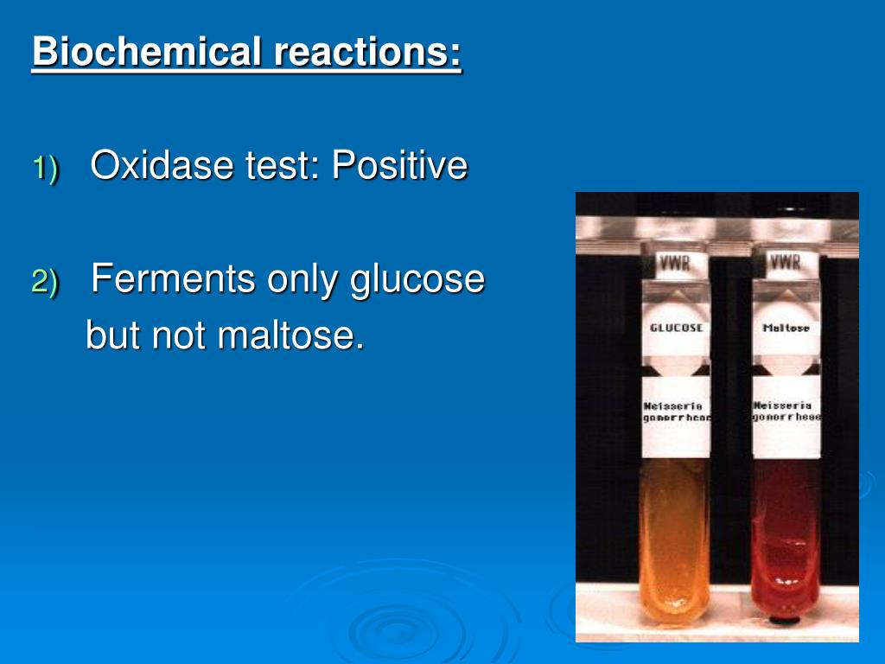
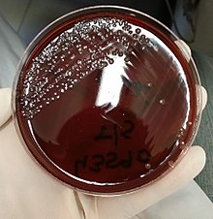
Ferment only glucose. chocolate agar.
Serology: Antibodies to gonococcal pili and Omps can be detected by immunoblotting, RIA or ELISA tests.

Slide 8
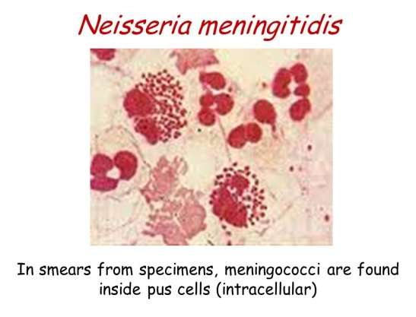
Neisseria meningitidis.
Characteristics:
• Gram-negative intra cellular diplococci.
• Present in the nasopharynx in 5-10% of healthy people.
Clinical manifestation:
. Meningococcal meningitis.
. Meningococcemia: Meningococcal septicemia.

Slide 9
Laboratory diagnosis:
Specimen: Cerebrospinal fluid, blood.
Smear: Gram-negative intracellular diplococci.
Culture: Transparent or grey, shiny, mucoid colonies in chocolate agar after incubation at 35-37Oc in a CO2 enriched atmosphere.
Biochemical reaction: Oxidase positive.
Ferment glucose and maltose in carbohydrate utilization test.
Serology: Latex agglutination test/ Hemmagglutination test.

Slide 10
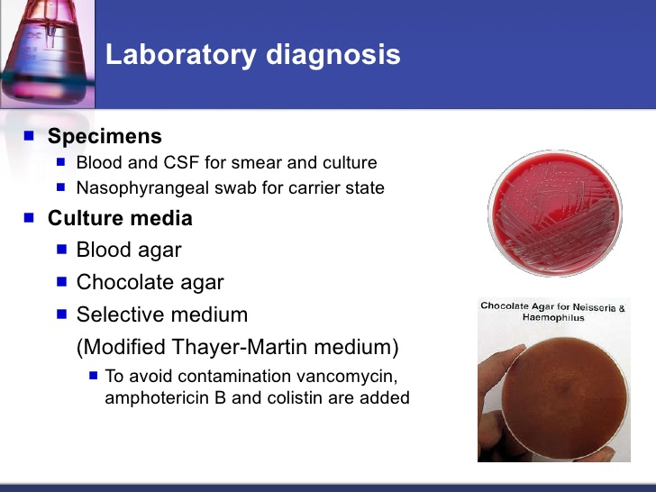

Slide 11
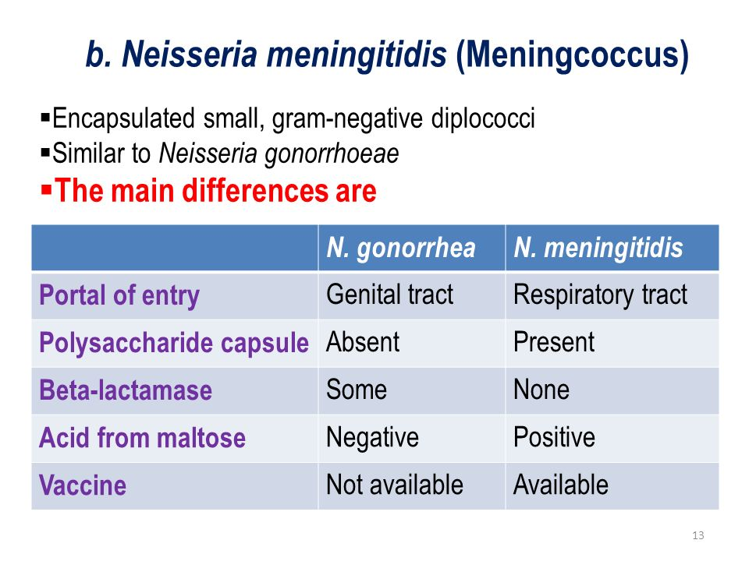

Slide 12


